Slide 1
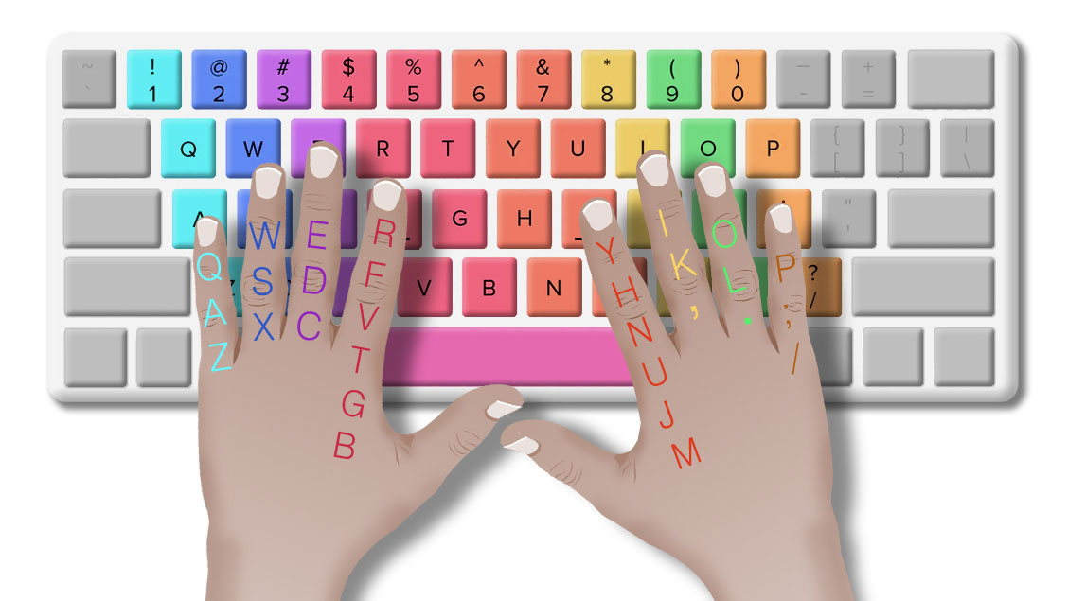

Project Presentation on Python

Slide 2
Team Members
Jiniya Xavier
Anurag Verma
Bibin Narayanan
Mithun Mohan

Slide 3

Objective
Typing Speed
Accuracy
Efficiency

Slide 4
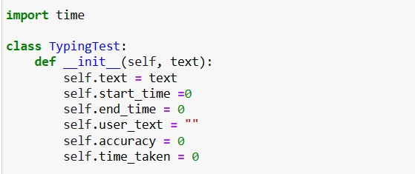
Summary of Code

Slide 5
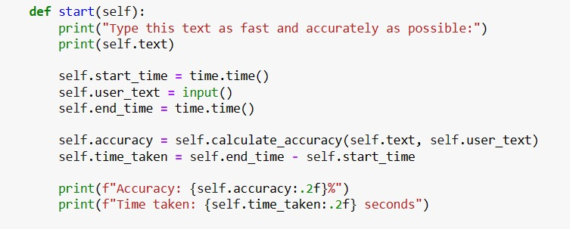

Slide 6
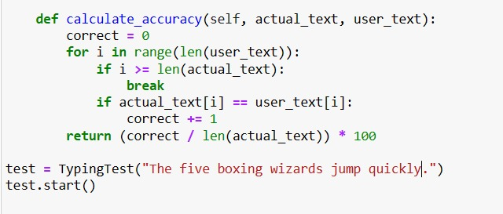

Slide 7

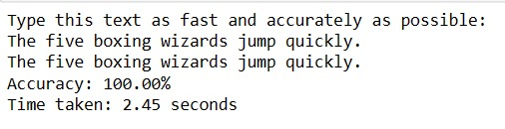

Slide 8

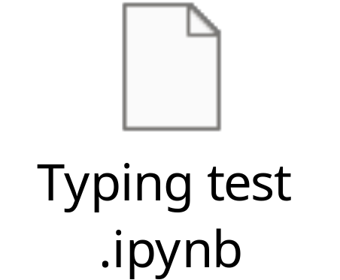

Slide 9

Typing tests are commonly used in job applications that require a lot of typing or data entry.
Typing tests are also used in educational settings, particularly in computer classes and keyboarding courses.
Job application process, particularly for positions that require typing proficiency, such as data entry, administrative work, and customer service.

Slide 10

https://github.com/reoyamanaka/timed_typing_test/blob/master/typingTest.py
https://www.w3schools.com/python/default.asp

Slide 11

Practicing the technique should be done on regular basis.
Typing tests are assessments designed to measure a person's typing speed and accuracy.
It's important to note that accuracy should be considered alongside typing speed, as a balance between the two is necessary for efficient typing.

Slide 12


